Slide 1
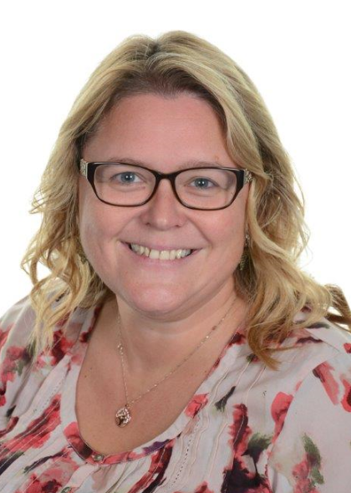
Welcome
Mrs T Lockley
Head Teacher

Slide 2
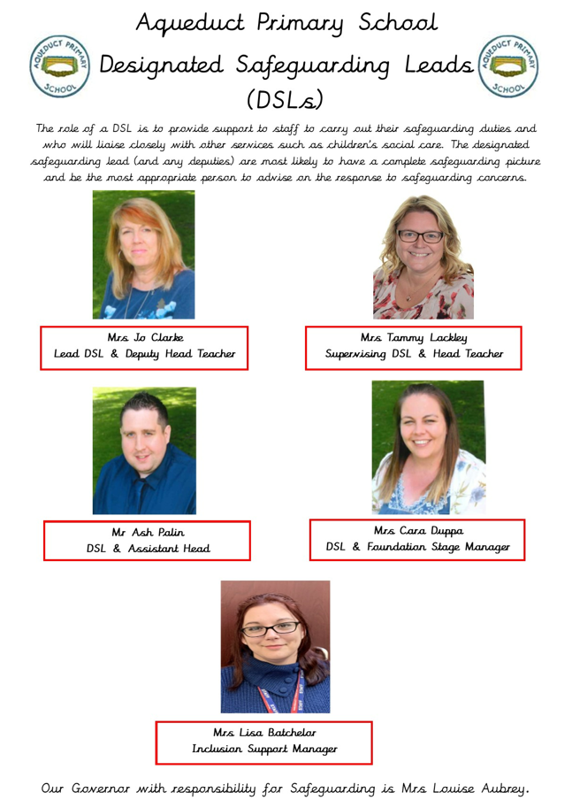
Our Designated Safeguarding Leads

Slide 3


School Governors
Chair of Governors –
Mrs Louise Aubrey
Our Governing Body has representatives from parents, staff and LEA.
We currently have a vacancy for a Parent Governor.

Slide 4
Key staff members
Mrs Mann/Mrs Lockley – Special Educational Needs coordinator
Mrs Batchelor – Inclusion Support Manager
Miss Stokes – Speech and Lang TA

Slide 5
Foundation Stage Staff
Mrs Duppa - Early Years Leader
Reception Class Teacher
TBC – Reception/Year 1
Reception Teaching Assistants
Miss Forde
Miss Bates
Miss Glynn
College students throughout the year.
(This is the projected staff for September)

Slide 6
Prospectus
Admission forms
Attendance
Absence reporting
Communication (Class dojo, ParentPay, Website, Twitter, Facebook)
Opportunities for your child to assist in decision making (School council, safeguarding board, wellbeing committee)

Slide 7
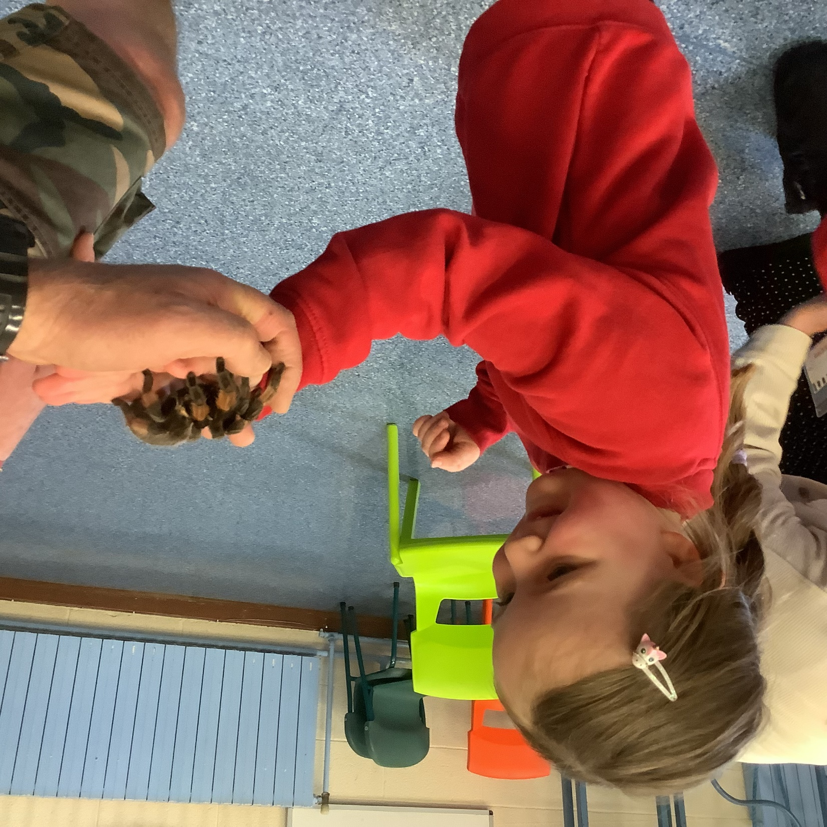
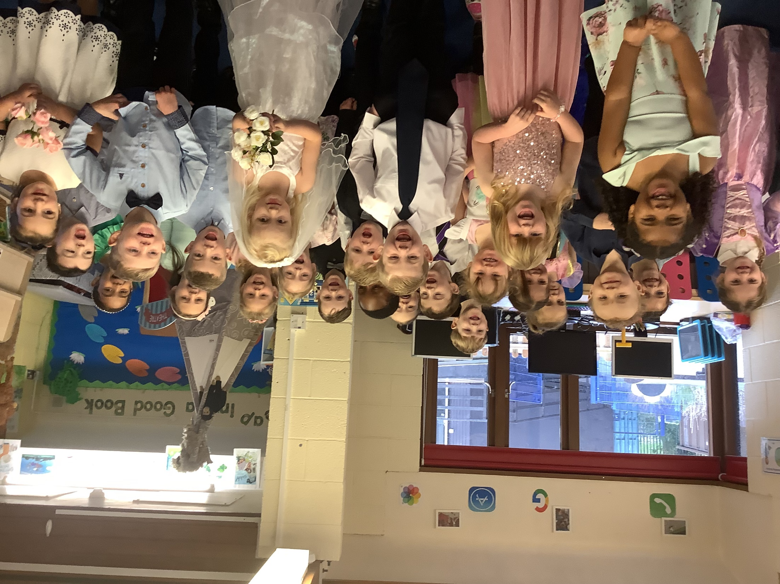
A day in the life of a Reception child...

Slide 8
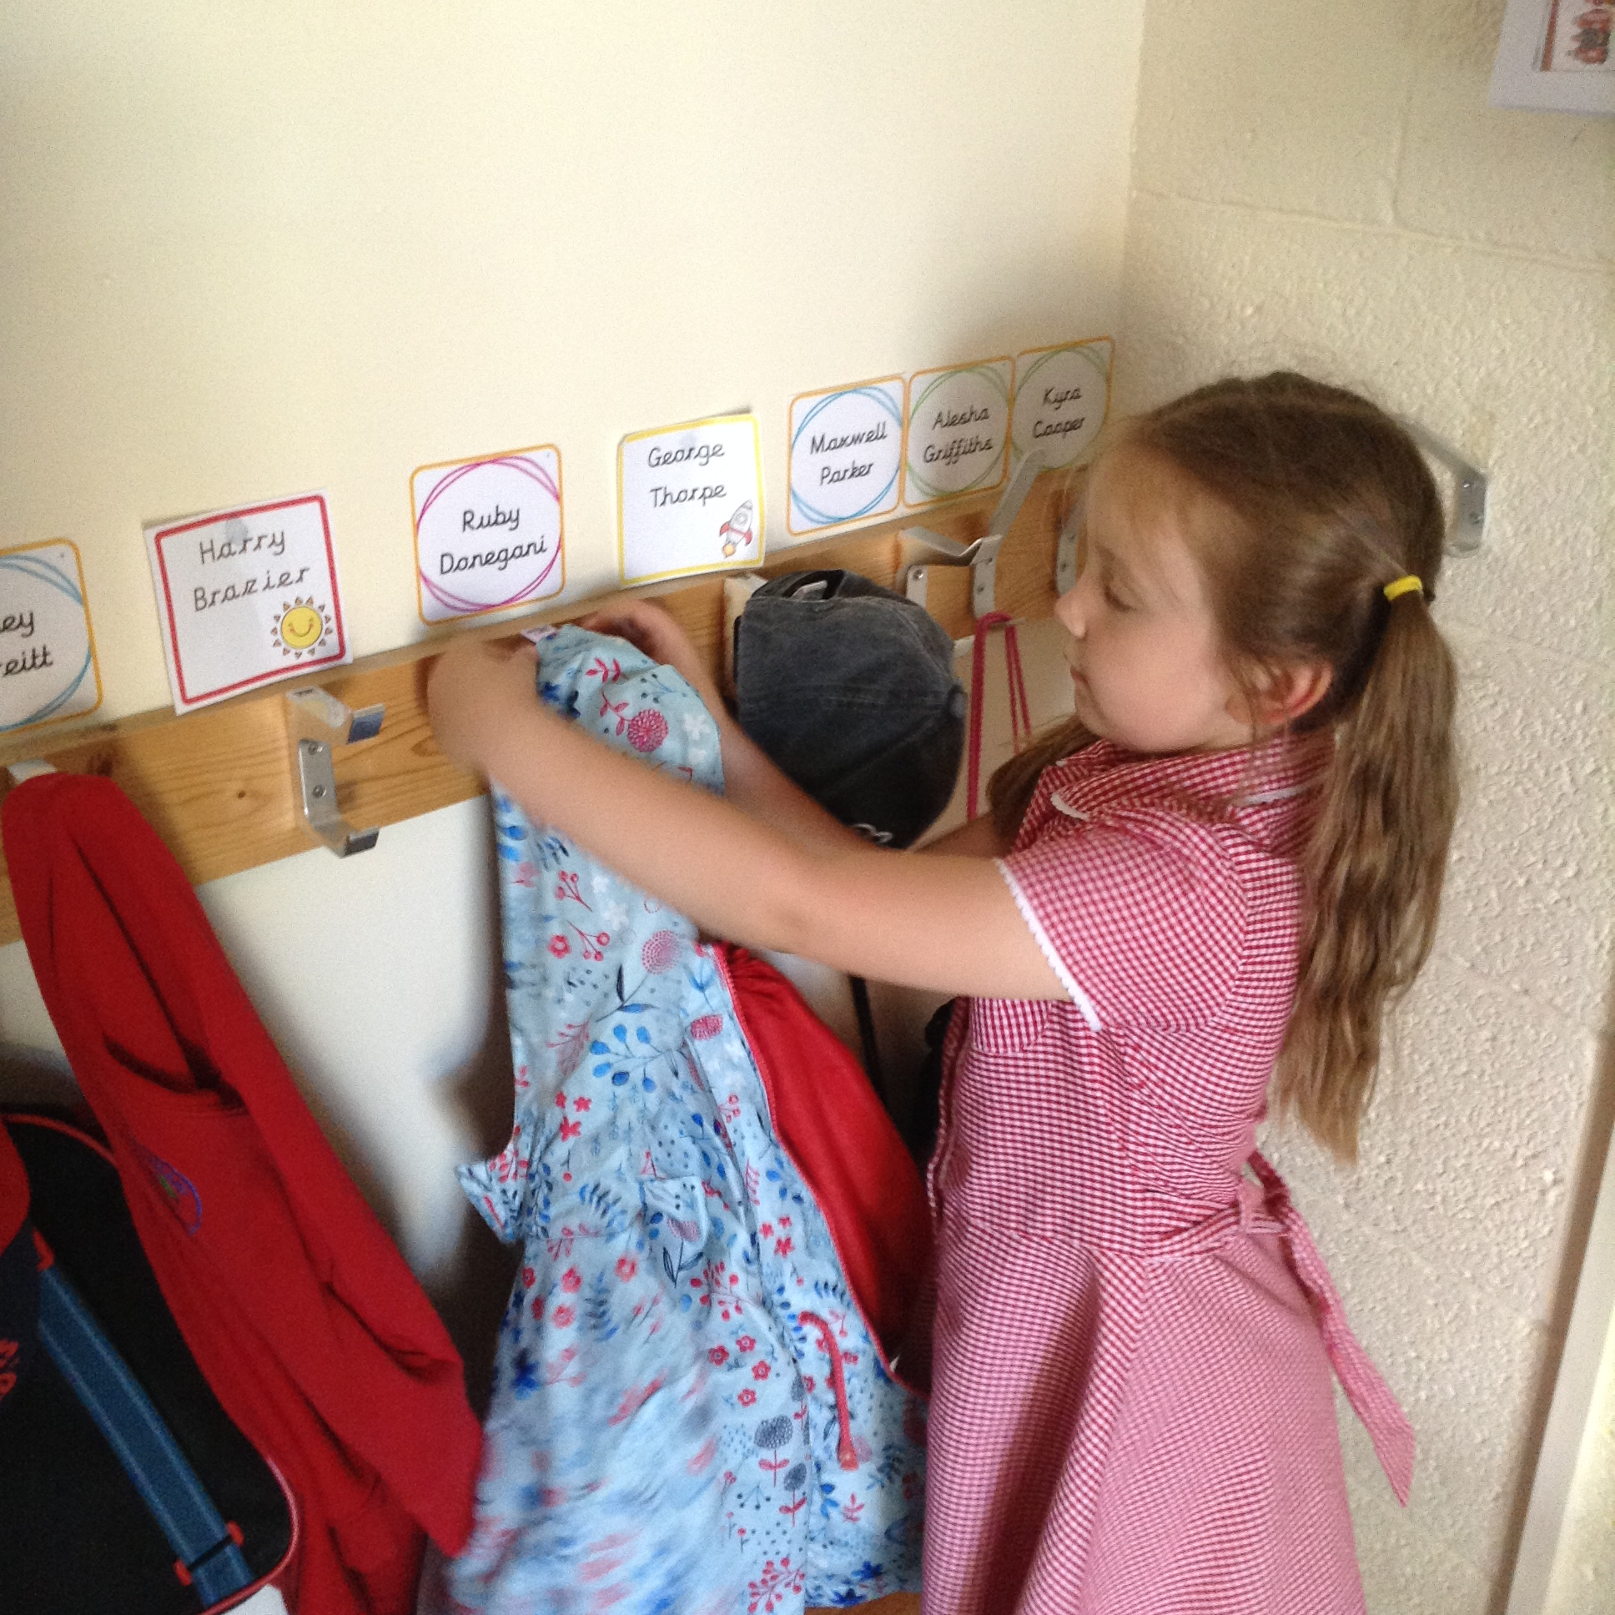
The day begins 8:45
We have parents say goodbye at the gate outside Class 1 from the first day. They will then go through to the classroom to start their learning.
From past experiences we have seen how quickly children settle and gain independence. Staff are on hand to help out in the mornings from the gates and inside the classroom.

Slide 9
Morning Timetable
8:45 Quiet Reading/interventions
9:00 Register
9:10 Guided Reading/interventions
9:30 Read Write Inc - Phonics
10:00 Funky Fingers (fine motor)
10:30 Break Time
10:45 Maths/Independent activities
11:30 Tidy, wash hands and get ready for Lunch
This is dependable on the children.

Slide 10


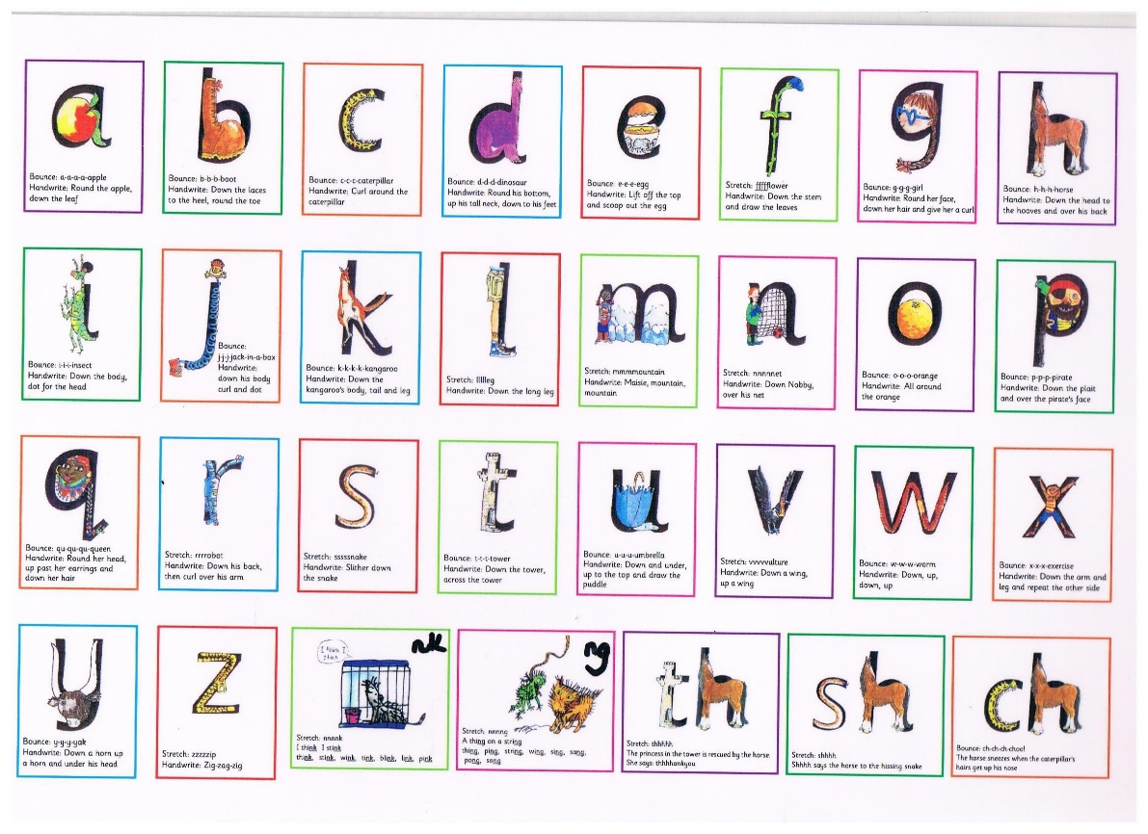


Read Write Inc

Slide 11

Handwriting

Slide 12
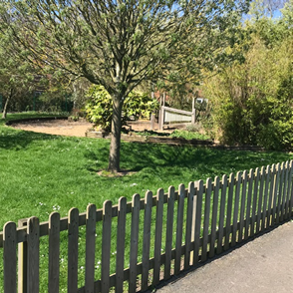
The afternoon
Continuous play provision indoors and outside
Welly Wednesday
Dough Disco
Mindfulness
Individual reading
sessions
PE Sessions
Observations/Interactions

Slide 13
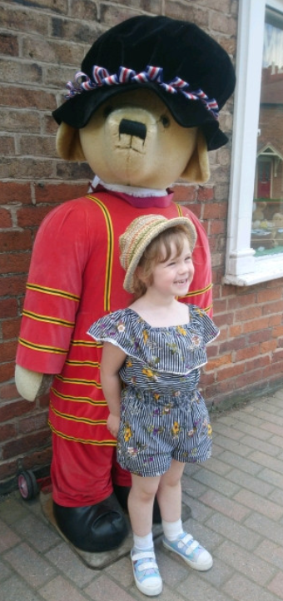
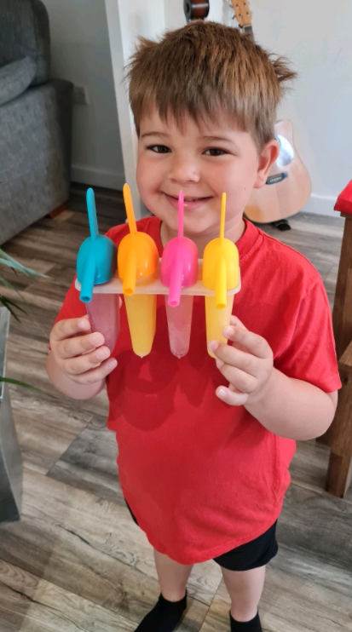
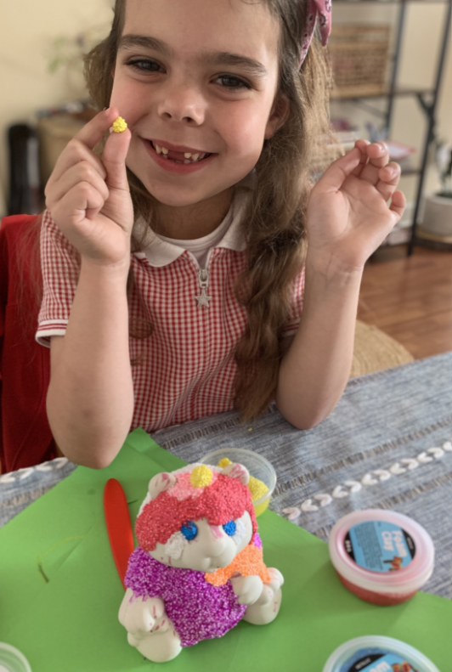
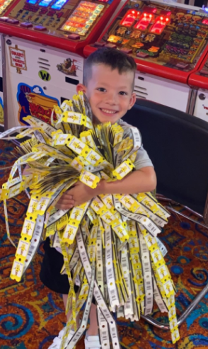
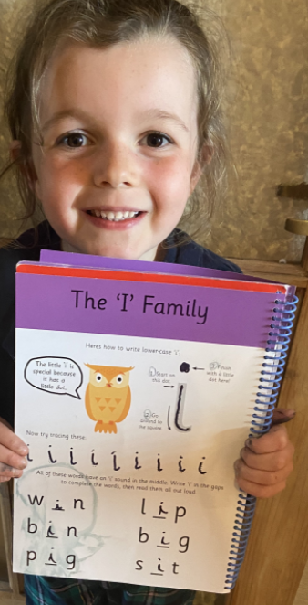
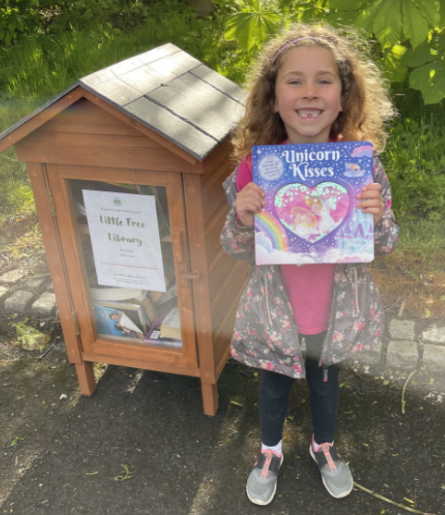
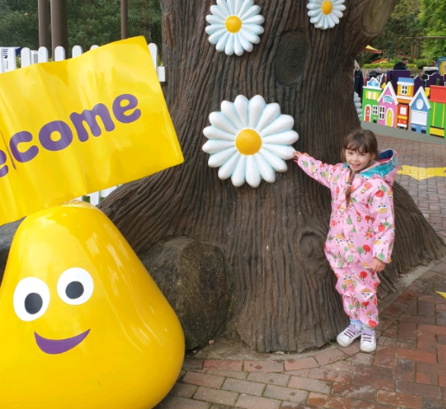
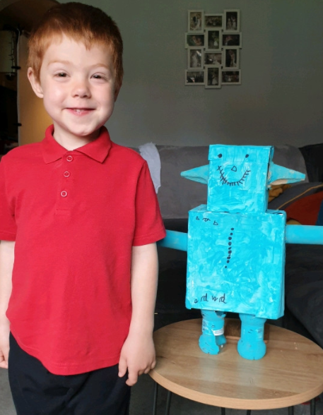
Home experiences

Slide 14
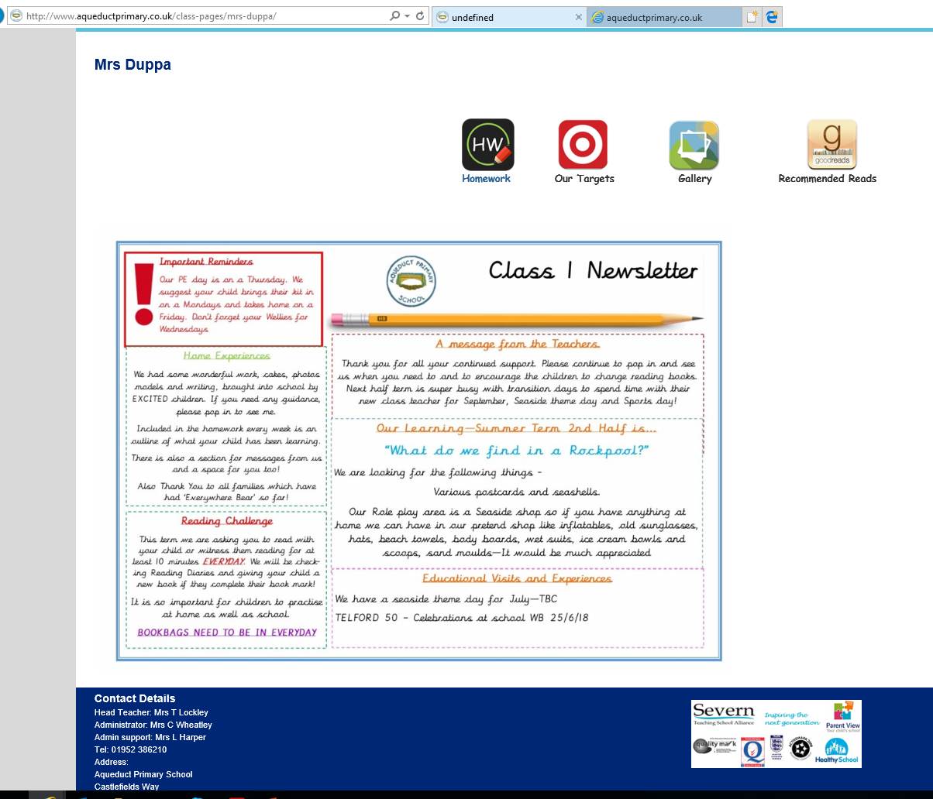
Class Pages – Mrs Duppa

Slide 15
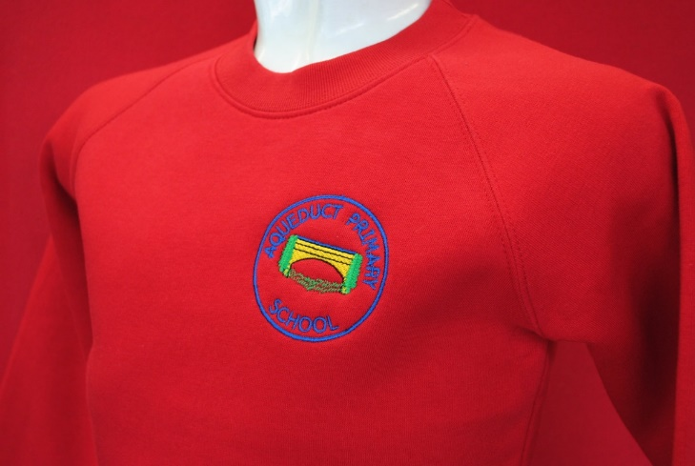
Our School Uniform
Boys
Black trousers/Shorts
White polo t-shirt/collared shirt
Red round neck school jumper with logo
Black shoes
Girls
Black skirt or pinafore
Red and white gingham summer dress
White polo t-shirt/ Blouse
Red round neck school jumper/Cardigan with logo
Black shoes
BOOK BAGS ARE RECOMMENDED
http://shop.schooluniformfactory.co.uk
https://www.bakerandsonschoolwear.co.uk/product-category/your-school/aqueduct-primary-school/

Slide 16
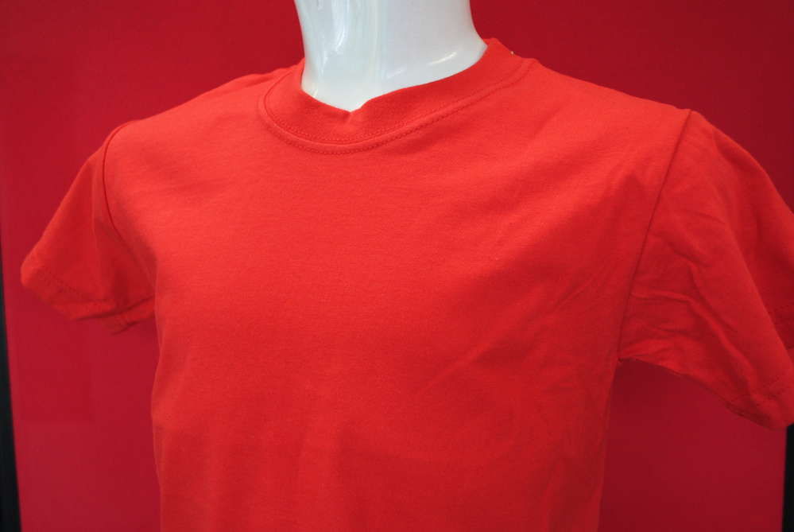

PE Kit
Plain Red t-shirt
Navy blue sports shorts
Navy bottoms
Black pumps/Trainers
Or our PE tracksuit (optional)
Please note all uniform must be labelled with your child’s full name.

Slide 17


After School Clubs
We have a number of clubs on offer each term, these are booked via ParentPay:
Forest school Dodgeball
Football Cooking
Minecraft Football
Crafts Yoga
Painting Zumba
Choir Cricket
Cross Country Pokemon club

Slide 18

How can I help in partnership with the school?
  Share an interest in your child’s work
  Praise and encourage your child’s efforts
  Listen to your child read
  Visit libraries and bookshops
  Encourage listening to audio tapes
  Sit and watch good television or videos with your child and talk about what you are watching
  - Talk Maths with your child all the time

Slide 19
Lunches
Free!
On the day ordering
Sandwich option
Encourage independence
Tasting available

Slide 20

Thank you
We are really looking forward to getting to know you and your children and we hope you are excited too!

