Slide 1

SENd Information Report
Aqueduct Primary Academy

Slide 2

Welcome
Here at Aqueduct Primary Academy, we are committed to providing a broad, accessible curriculum to all our children.
Mrs Mann is the SENCo (Special Educational Needs Co-Ordinator) working very closely with the team of teachers and support staff that we have here at Aqueduct.
If you are ever concerned about your child’s progress or development, please speak to the class teacher in the first instance. The teacher can then complete a referral form to request SENCo support or advice if needed.

Slide 3

contents
What types of SEND are provided for?
How does the school identify and assess children with SEND?
Quality First Teaching
Click on one of the links to find out more information about SEND at Aqueduct Primary Academy.
The Graduated Approach
Referral for an EHCP
Interventions
How does the school communicate with me and my child?
How does my child have his/her say?
How will my child be supported with transitions?
What is our SEND ethos and approach?
SEND facilities
SEND Resources
Staff training
Where can I find SEND support and information?
Problems and complaints
Notes:
Quality First Teaching

Slide 4

What is Our SEND ethos and approach?
We have an inclusive ethos in all areas of school life, including teaching, learning and the curriculum. We use inclusive, targeted quality first teaching from the class teacher with adapted planning to support ALL children to access the curriculum at their level. Learning support assistants (LSAs) are also used in lessons to support individual pupils or groups.
Pupils with SEND have opportunities to take part in all extra-curricular clubs and join in with trips and visits. Assemblies and the curriculum are used to raise awareness, promote diversity, and discuss issues such as bullying and discrimination.

Slide 5
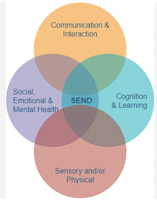
What types of SEND are provided for?
We are an inclusive school that aims to meet the needs of ALL learners. A pupil has SEND where their learning difficulty or disability calls for special educational provision; this is provision different from or additional to the Quality First Teaching that is normally available to pupils of the same age. The types of SEND that are provided for fall under 4 broad areas:
Communication and interaction: Children with speech, language and communication needs have difficulty in communicating with others. This may be because they have difficulty saying what they want to, understanding what is being said to them or they do not understand or use social rules of communication.
Cognition and learning: Learning difficulties covers a wide range of needs, including moderate learning difficulties, severe learning difficulties, through to profound and multiple learning difficulties where children are likely to need support in all areas of the curriculum and have associated difficulties with mobility and communication. Specific learning difficulties, affect one or more specific aspects of learning - this encompasses a range of conditions such as dyslexia and dyscalculia.
Social, emotional and mental health difficulties: Children may experience a wide range of social and emotional difficulties which manifest themselves in many ways. These may include becoming withdrawn or isolated, as well as displaying challenging, disruptive or disturbing behaviour. These behaviours may reflect underlying mental health difficulties.
Sensory and/or physical needs: Some children require special educational provision because they have a disability which prevents or hinders them from making use of the educational facilities generally provided. These difficulties can be age related and may fluctuate over time. Many children and young people with vision impairment, hearing impairment or a multi-sensory impairment will require specialist support.

Slide 6
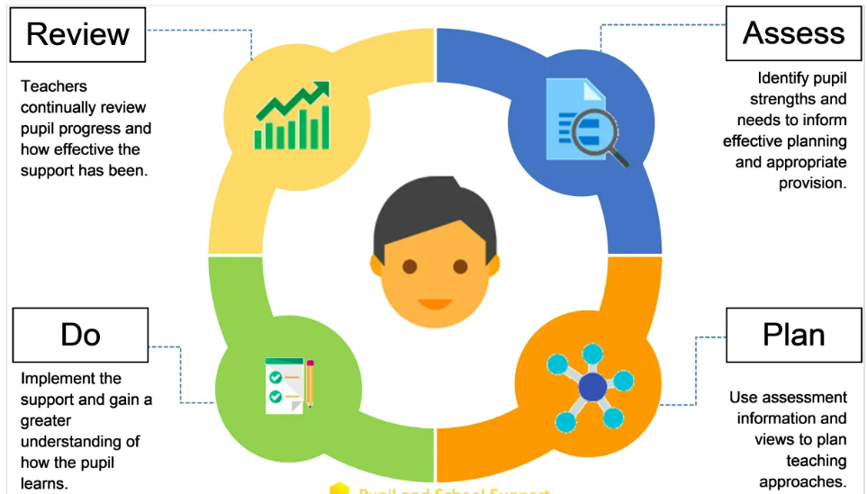
How does the school identify and assess children with Send?
At Aqueduct Primary Academy, we know that early identification leads to early help for a child which will reduce the chances of them falling behind. Information to help identify children with SEND is gathered from:
Parents/carers and the child’s views
School staff
School-based assessments
Our school assesses each pupil’s current skills and level of attainment on entry, building on information from previous settings and key stages where appropriate. Class teachers make regular assessments of progress for all pupils in pupil progress meetings. Here, children may be identified as making less than expected progress.
Children are identified as having a special educational need if:
The child’s progress is significantly slower than that of their peers starting at the same baseline.
The child makes progress that fails to match or better the child’s previous rate of progress.
The child fails to close the attainment gap between the child and their peers.
The attainment gap widens.

Slide 7
What do we mean by Quality first teaching?
For your child this means:
That the teacher has high expectations for all pupils in their class.
That all teaching builds on prior learning and what they already can do and understand.
A range of styles of teaching are in place so that your child is fully involved in and accessing the learning. This may involve observational, listening and practical learning. Children have access to resources in the classroom that will support their learning.
Your child’s teacher will have tracked their progress and will share any concerns they have about your child regarding their learning that they feel may need more specialist support, intervention or advice .
Class teachers complete an Assess, Plan, Do, Review (APDR) process for a child identified with a SEND need. They will constantly monitor their progress and needs and adapt teaching and learning to suit their needs as best as possible. These are evaluated twice yearly, at the end of each term, so that provision can be adapted where necessary, but can also be utilised as a working document, if your child’s needs change throughout the year.
Specific strategies/programs (which may be suggested by the SENCO or outside agencies), are in place to support your child to learn.
We have experienced Learning Support Assistants (LSA) that work within classrooms to support teaching and learning.
For your child this means:
That the LSA has high expectations for all pupils they support.
That all support is based on what your child’s needs are and various teaching and learning styles will be practiced depending on the child.
That the LSA works with the Teacher to support the teacher’s planning and assessment to develop your child’s learning and support their progression.
They may take place in intervention groups if their teacher feels that this will benefit your child, this may include; additional writing support outside of the daily English lesson or additional reading/phonics. These activities may be run by a teacher and/or learning support assistant who has had training to run the group such as precision teaching, speedy reading or RWI.

Slide 8
What do we mean by Quality first teaching?
Evaluating Quality First Teaching
Teachers receive quality training and support to ensure that the teaching they provide is the best it can be. This is monitored by the Senior Leadership Team (SLT) and may impact future training.
Children’s progress and attainment is regularly monitored by teachers. They are assessed termly and this data is analysed by the Senior Leadership team. Interventions are evaluated half-termly by the member of staff leading them to review their impact and adaptations are made if necessary.
Children’s APDR’s are completed each term to evaluate provision and make adaptations where necessary. This highlights progress made and ensures provision is relevant, up-to-date and has an impact.

Slide 9
Quality first teaching
All children should be able to access high quality first teaching in their class. Our teachers work incredibly hard to adjust the learning in their class to meet the varying needs of all pupils.
Cognition & Learning QFT Strategies | Communication & Interaction QFT | SEMH QFT Strategies | Sensory & Physical QFT Strategies
Clear targets for ‘Next Steps’; building on what pupils can already do | Increased visual aids including use of a visual timetable | Clear, consistent reference to behaviour charts/Life Values with praise/reward | ICT ease of access settings e.g. magnifier
Make explicit links to prior learning and recap key learning points throughout and at end of lessons (overlearning) | Eye contact or pupil’s name used to gain attention before giving information or instructions | ‘Catch’ pupil ‘being good’ and provide regular, specific praise/reward. Use of Brilliant Book | Coloured overlays or different coloured paper. Coloured background on interactive whiteboard screen
Instructions given in small chunks with visual cues | Key words/vocabulary emphasized when speaking and displayed visually | Give classroom responsibility to raise self esteem | Consider lighting – natural and artificial
Opportunities to work with a scribe, in small groups or using ICT. | Minimize use of abstract language, idioms etc | Use of ‘now/next /then’ board with visuals | Ensure appropriate print size photocopies
Ask pupils to explain tasks to clarify understanding | Information or instructions in manageable chunks | Play calming music/sounds where appropriate | Consider seating – in front or close to the board/resources/teacher
Minimize copying from the board: copies for individual pupils where needed | Simple checklist/task lists with visual cues. | Communicate in a calm, clear, consistent manner | Keep background noise/distractions to a minimum
Additional thinking time or time to complete tasks | Delivery slowed down with more time given for processing | Use post-its for questions rather than interruptions | Repeat contributions from children that speak quietly
Key words/vocabulary clearly emphasized and displayed in room | Clear modelling of what is expected to support auditory processing | Interactive strategies e.g. holding up answers, come to front to take a role etc | Face pupils when speaking and keep hands away from mouth
Use alternative ways to record learning – mind maps, voice recorders, ICT, writing frames, sorting, scribe | Non-verbal feedback system to demonstrate whether something has been understood. E.g. thumbs up | Visual timer used to measure and extend time on a task | Left handed and right handed pupils not next to each other with adjacent hands
Learning buddies/talk partners | Use of Talking Partners to encourage, but not replace, verbal responses | Quiet area or safe space available for calming/working if needed | Sloping desk stand if appropriate
Alphabet strips/phoneme mats/key spellings on desk | Effective use of questioning and encouraging children to ask and answer questions | Alternative seating for tasks/carpet time, or wobble cushions if needed | Lined paper with sufficiently wide spaces
Whiteboards/pens available to make notes, try out spellings, record ideas & remember | Range of multi-sensory approaches used to support spoken language e.g. pictures, concrete apparatus, role-play, artefacts | Use of fiddle toys for anxiety/calming | Read aloud as you write on the board
Multi-sensory resources used | Quiet, distraction free workstation available if needed | Provide opportunities to demonstrate skills and build self-confidence | Use of ear defenders
Pre-teach key vocabulary | Parents advised of new vocabulary so it can be reinforced at home | Consider seating arrangements – focus on triggers, self esteem etc | Use of sensory toys for calming/provide sensory breaks
Clearly presented text and fonts with tasks/resources adapted to suit ability | Ensure preferred methods of communication are shared with key staff | Provide movement breaks/brain breaks | Use of weighted blankets
Model and scaffold learning and teach/model memory techniques | Model good language and extend vocabulary | Ensure that tools/equipment/concrete resources are easily at hand | Pencil grips/left handed scissors/rulers with handle

Slide 10

INTERVENTIONS
If quality first teaching is not enough to meet a child’s needs, then we put in place time-limited, evidenced-based interventions to target skills that we have identified as being delayed in developing for a child. The aim is for the child to catch up and to be age-appropriate with that skill. If this does not work, then we put in place personalised curriculums or provision on an individual basis to meet a child’s individual needs.
Communication & Interaction | Cognition & Learning | Social, Emotional & Mental Health | Sensory and/or Physical
TalkBoost – EYFS, KS1 & KS2 We are pleased to be a part of this years Early Language Support for Every Child (ELSEC) programme. A part of | Read Write Inc Precision teaching | Emotional Literacy support (ELSA) | Sensory circuits Physical interventions with our PE lead

Slide 11

Referral for an EHCP
An EHC Needs Assessment can be requested when a child has a learning difficulty or a disability and is not making the progress expected with the support that is being put in place, or the parents of the child believe that the education setting is not able to provide the help and support which is needed.
Families and schools are encouraged to work together to discuss the provision in place for a child and decide if/when statutory assessment is appropriate. An EHC Needs Assessment is usually requested by the school but can be requested by a parent.
An EHC Needs Assessment may result in an Education, Health and Care Plan (EHCP) being issued. Parents have the right to appeal against a decision not to issue an EHC Plan.
An EHCP is a document which sets out the education, health and social care needs of a child and the support that is necessary to help them to progress and achieve their outcomes (for some this may be up to age 25).
Once the EHCP has been completed and agreed, it will be kept as part of the pupil’s formal record and reviewed at least annually by staff, parents and the pupil at an Annual Review meeting.

Slide 12
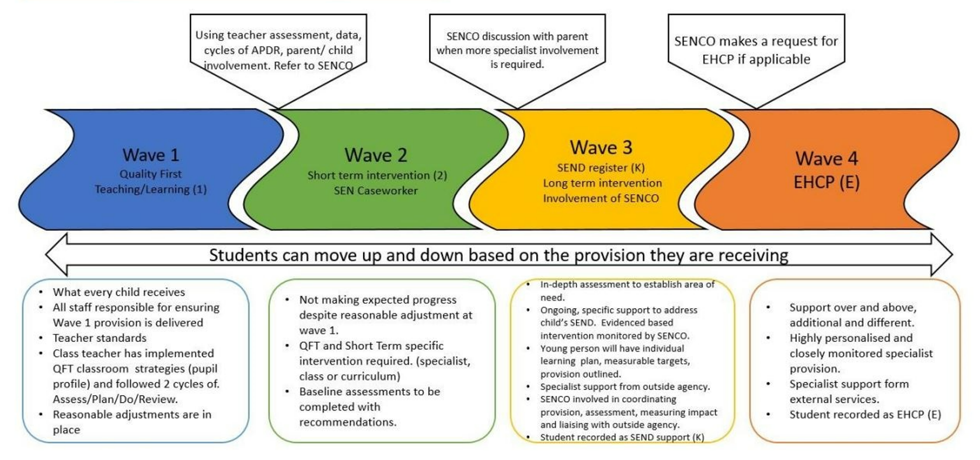
The graduated approach
The SENDCo identifies children with SEND through cycles of assess, plan, do, review.

Slide 13

How does the school communicate with me and my child?
We value the importance of good home-school communication. All children on the SEND register have an Assess Plan Do Review (APDR) – this outlines your child’s targets and SEND provision. This is reviewed termly and your child also shares their ‘Pupil View’ when these are being completed. In addition to this, your child will have also completed a one page profile with their class teacher. During this the voice of your child is listened to as they share what they like and dislike and what they think their barriers to learning are and what they find works to overcome them.
We also share information in the following ways:
Parents’ evenings with parents, children & teachers in Autumn 2 and Spring 2.
Monthly newsletter.
Information on our website.
Class Dojo, Arbor & email.
Annual reports.
Annual Review Meetings (for children with an Education, Health and Care Plan).
Team Around the Family (TAF) meetings (where outside agencies are involved).

Slide 14

How does my child have his/her say?
We talk to the children regularly about their learning and progress.
Children are encouraged to support making their One Page Profile, annually, to share their views.
Children are invited to parents’ evenings to share their views.
Each class also has a Pupil Parliament representative to share their views, which includes children with SEND.
The school is continually developing ‘Pupil Voice’, where children can share their ideas, thoughts and views about the learning they do.
There is a consistent approach to children being a part of their learning journey. We have a positive school community and the children are taught that they are able to speak to any adults in school about their learning, thoughts and feelings.

Slide 15
How will my child be supported with transitions?
Transitions from pre-schools/nursery schools:
Pupils due to join our reception class receive a visit at their pre-school/nursery/home setting from the EYFS lead. The children visit the school/classroom prior to starting and meet with staff. Where a child already has identified special educational needs, the SENCo will also visit the child in their pre-school setting. The SENCo and/or Reception class staff will attend pre-school TAC meetings prior to a child with SEND attending school if appropriate. If suitable a child may be encouraged to visit their new setting multiple times.
Transitions from class to class:
Prior to the start of a new academic year, class teachers and LSAs receive information about the SEND children in their class, including their Assess, Plan, Do, Review (APDR) and One Page Profile. Relevant training/courses is arranged for teachers/LSAs as needed.
In the Summer term prior to the new academic year transition mornings take place to meet the new teacher and class. If suitable a child may also be encouraged to briefly visit their new teacher multiple times to become more familiar with their new teacher, classroom.
Transitions to/from another primary school:
All children with SEND can visit the school and have a tour prior to starting to familiarise themselves with the staff, school structure, and main sites including toilets, hall, playground etc.
We have a highly skilled pastoral team to monitor well-being and Playground Pals to help children make new friends.
All school SEND records are passed on to any other school a child transfers to.
Transitions to secondary school:
Staff at Aqueduct Academy endeavour to communicate with the SENCo of any Secondary School due to receive any of our SEND pupils to discuss the specific needs of the child. Families are always included in any meetings, as are the teacher, SENCo and child.
Where possible your child will visit their new school on several occasions and in some cases staff from the new school will visit your child here at Aqueduct.

Slide 16
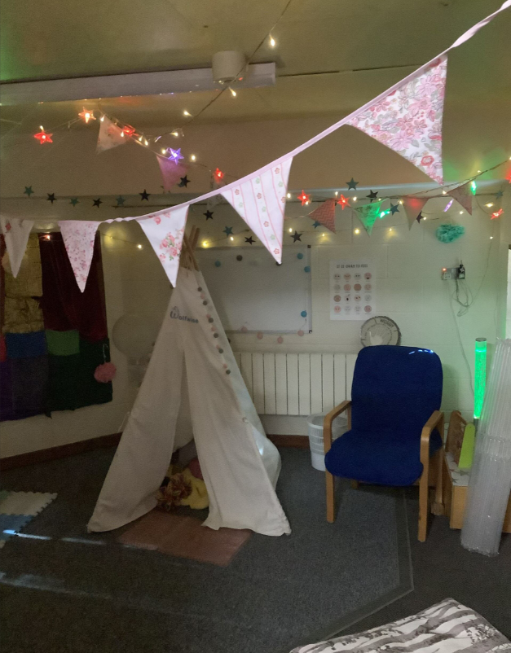
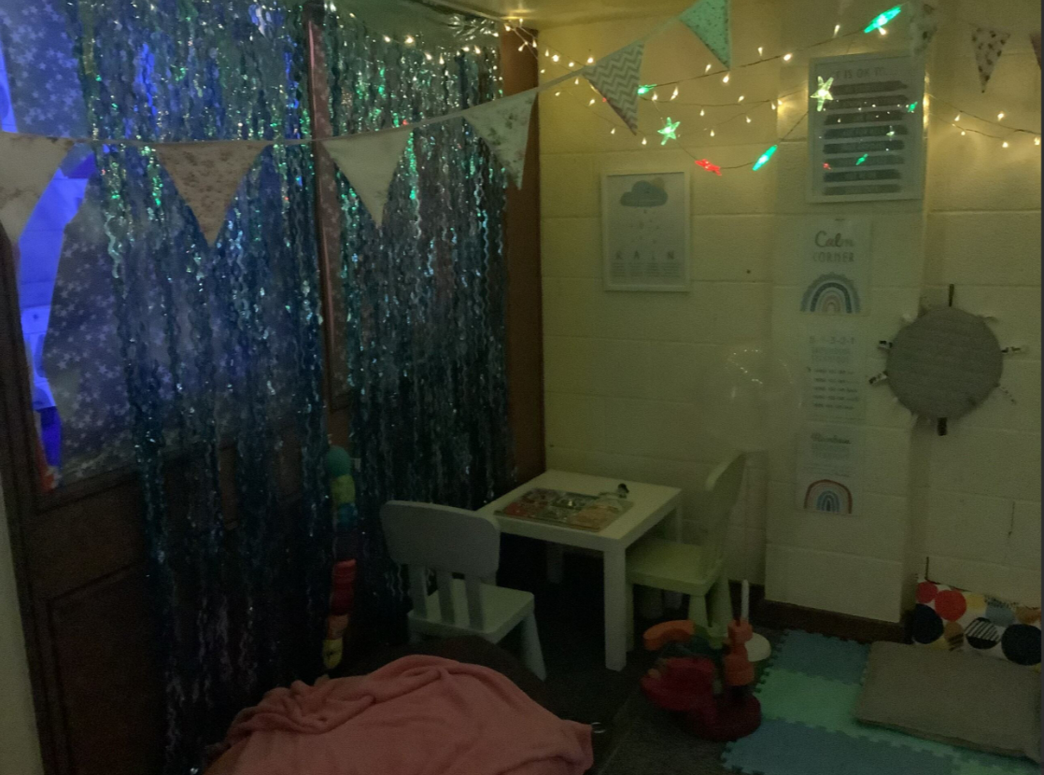
SEND Facilities
We have a fully accessible school building (including stairlift) and an accessible toilet with hoist. We also have breakout spaces across the school, for quieter focused support, including a sensory room and ‘mini’ pitstop.
Our Pitstop is used for social, emotional and mental health interventions with our Inclusion Support Manager Mrs Batchelor.

Slide 17
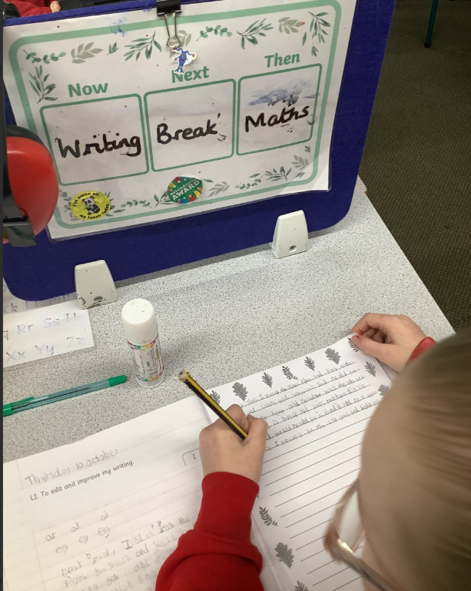
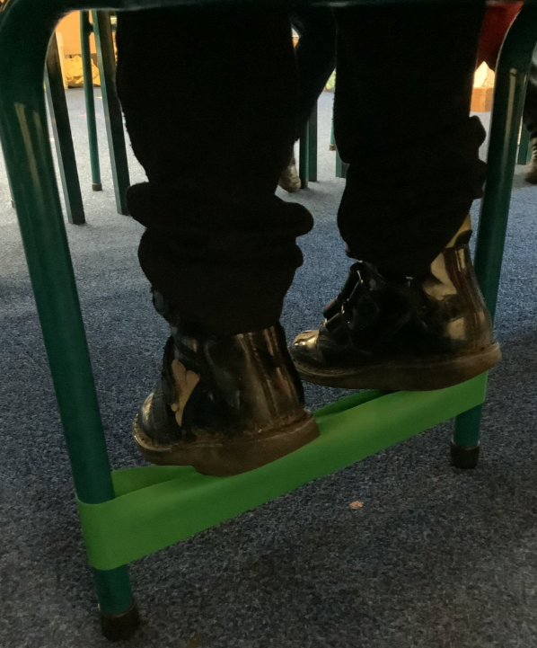

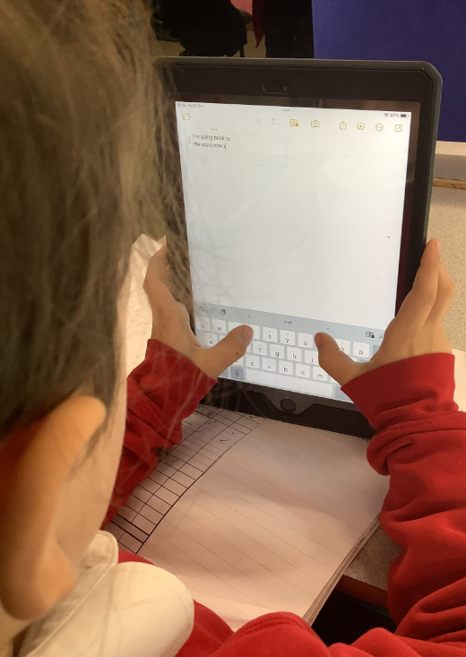
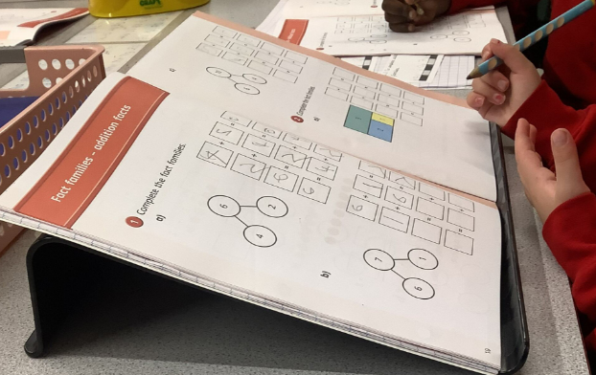
SEND resources
All children in school have access to equipment and resources to support them in their learning such as sound charts, number lines etc. These resources are available for children to access themselves.
We have a wide range of SEND resources and equipment for use throughout the school if needed or recommended.
We are also visited twice a week by Nugget, our school dog, who works with Mrs Batchelor and our children.
Classroom based resources include:
Writing and foot slopes
Pencil grips
Specialist cutlery
Fiddle toys
Stress balls
Ear defenders
Balance balls
Wobble cushions
Coloured overlays/ exercise books
Weighted blankets/ cushions
Reading scanner pen
Electronic spelling dictionaries
A range of apps accessible on the school Ipads

Slide 18

Staff Training
We strongly believe that staff development allows us to better understand and, therefore, meet the needs of our children. Staff training is an ongoing process.
The SENCo is a qualified teacher who holds the National Award for SEND Co-ordination, this is Mrs Mann.
Our Inclusion Support Manager, Mrs Batchelor and additional learning support staff are trained in Emotional Literacy support, who also attend regular updates.
The SENCo attends regular SENCo up-date meetings and forums run by the Local Authority and Reach2 relating to the needs of pupils within the school. Training/ updates are then disseminated to staff through regular staff meetings, these have included guest speakers such as the Educational Psychologist, member of the Multicultural Development Team etc.
Regular opportunities are given to staff to attend courses on relevant SEND topics.
Staff training needs are also supported through PD days, peer mentoring and coaching, modelling, observation, working with outside agencies and staff meetings.
All staff have attended Autism Education Trust training.
Staff are currently on a journey of ‘Adaptive Teaching’ and how we can ensure the best curriculum and learning opportunities are available and accessible to all our pupils.

Slide 19


Telford and Wrekin Local Offer (SEND - Local offer (telfordsend.org.uk) has a wealth of information for children and young people with SEND and their parents and carers about education, health and care services, leisure activities and support groups they can access.
Telford SENDIASS (Special Educational Needs and Disabilities Information Advice and Support Service) is a confidential and impartial information, advice and support service on issues related to SEND. It is free, easy to access and confidential (Telford SENDIASS | SENDIASS Telford).
We are also able to invite agencies from the Local Offer to our parent drop in sessions. Look out for these through the course of the year.
Our SEND Policy contains more information – this can be found on our school website (Aqueduct Primary Academy).
Where can I find SEND support and information?

Slide 20
Concerns and Complaints
At Aqueduct Primary Academy, we encourage parents to get in touch if they have any concerns about their child’s learning. However, if you are unhappy with the special educational provision that your child is receiving:
Your first approach is to speak to your child’s class teacher – you can visit or telephone the school office to make an appointment.
If the problem or concern persists, the next step is to speak to the SENCo by arranging an appointment via the school office 01952 984980.
If necessary, the next step is to approach the Head Teacher, you can make an appointment via the school office. It is the Head’s job to hold staff to account if things are not right, or to explain why the school is unable to meet a request. We encourage parents to share concerns early so that they do not become a problem.
If your concerns are not resolved, please see our Complaints Policy for advice on how to proceed, this can be found on our school website.

